Slide 1








Delicious Pizza for Everyone!
PIZZA
BOXCAR
@reallygreatsite

Slide 2

Business Problem
The store needs to boost revenue and efficiency by identifying top-selling pizzas ,peak sales times and optimizing inventory to avoid missed opportunities and potential revenue loss.

Slide 3


AIM
To analyze pizza sales data , focusing on revenue , order trends and make business decisions.

Slide 4
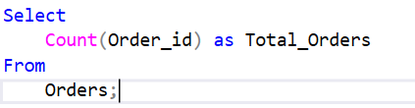

1.Retrieve the total number of orders placed.

Slide 5


2.Calculate the total revenue generated from pizza sales

Slide 6
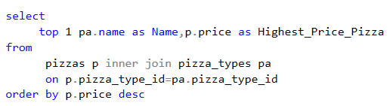

3.Identify the highest-priced pizza

Slide 7
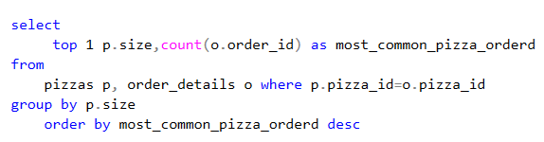

4.Identify the most common pizza size ordered

Slide 8
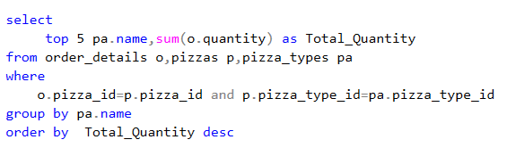
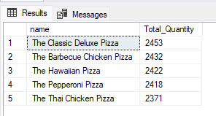
5.List the top 5 most ordered pizza types along with their quantities

Slide 9
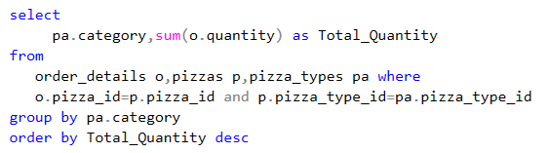
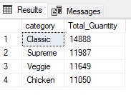
6.Join the necessary tables to find the total quantity of each pizza category ordered

Slide 10
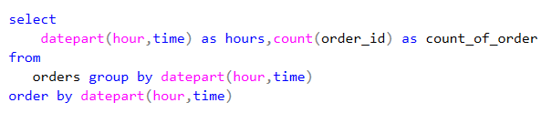
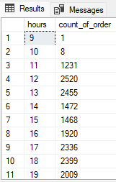
7.Determine the distribution of orders by hour of the day

Slide 11

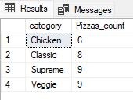
8.Join relevant tables to find the category-wise distribution of pizzas

Slide 12
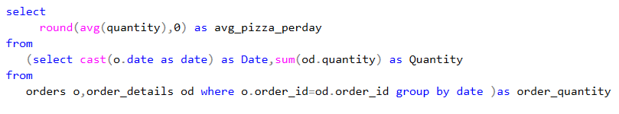

9.Group the orders by date and calculate the average number of pizzas ordered per day

Slide 13
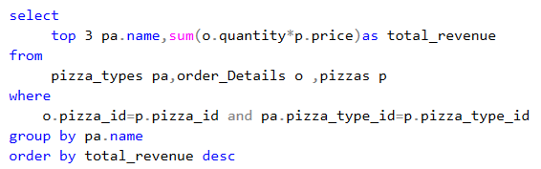
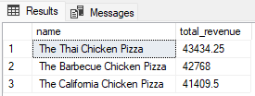
10.Determine the top 3 most ordered pizza types based on revenue

Slide 14
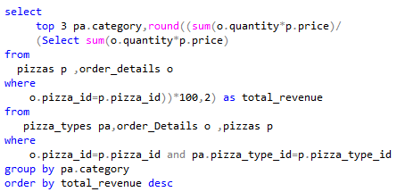
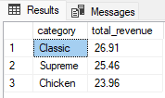
11.Calculate the percentage contribution of each pizza type to total revenue

Slide 15
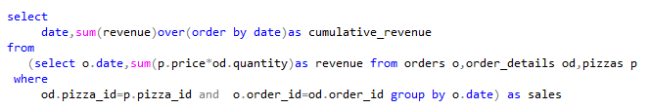
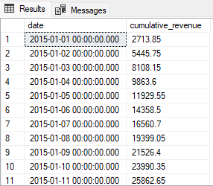
12.Analyze the cumulative revenue generated over time

Slide 16
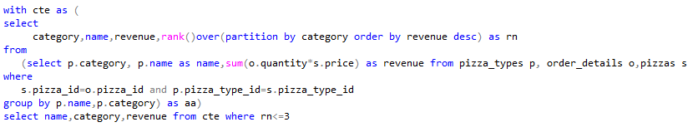
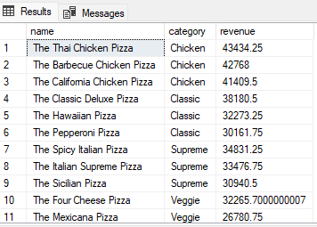
13.Determine the top 3 most ordered pizza types based on revenue for each pizza category

